Slide 1
RCP / RSP
Airbus perspective
Presented by
Jerome CONDIS / FANS Projects (all program)

Slide 2
Agenda
Demonstration of compliance with RCP/RSP specifications
Avionics configuration and certification
Demonstration strategy
Availability, integrity and continuity
Time
Configuration Management of FANS certification
Operational notion of RCP/RSP in the cockpit

Slide 3
Airbus FANS avionics architecture

Slide 4
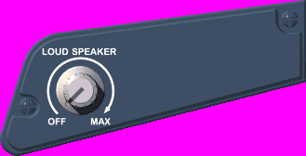
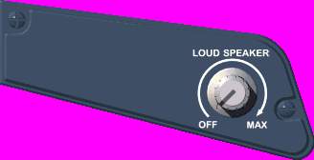
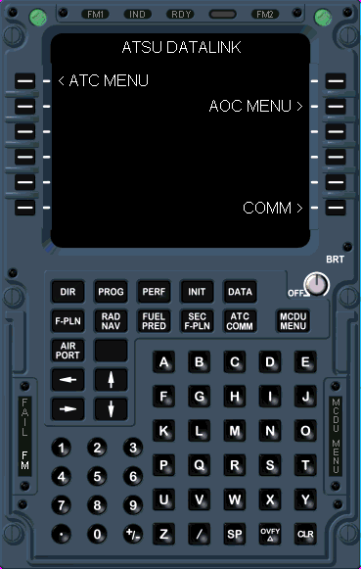
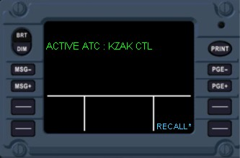
Controls & Indications common to
FANS A+ and B+
A320/A330/A340

Slide 5
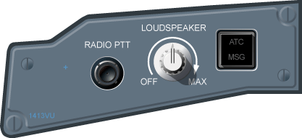
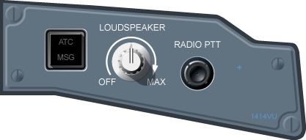
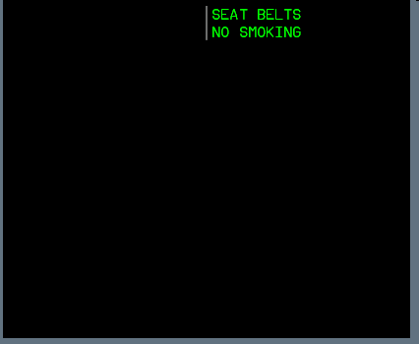
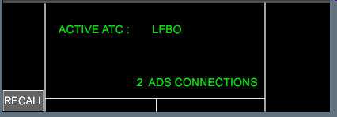
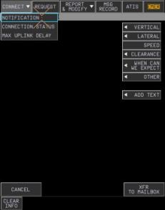
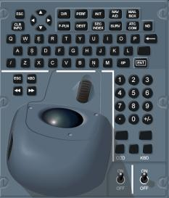
Controls & Indications common to
FANS A+ and B+
A380/A350
Commonality with A320/330/340 operating principles
A350/A380 Cockpit interactivity
=
More efficient workflow

Slide 6
Demonstration of compliance with RCP/RSP
For latest FANS 1/A+ (resp. FANS B+) developments, ED-122/DO-306 (resp. ED-120/DO-290) specifications are used as a basis
Demonstration that RCP/RSP allocations to the Aircraft are met are part of the aircraft FANS function airworthiness approval
ATC Data Link systems and FANS function certification are required but not sufficient to operate FANS on an aircraft
Operational approval, under operator responsibility, is required
Conditions of use may affect the actual performance of the avionics equipment (e.g. if significantly different from assumptions taken for avionics certification)
Tests are made using a representative ground ATC simulation
Some end-to-end tests are performed with real ground ATC systems, but not exhaustively of course

Slide 7
Demonstration of compliance with RCP/RSP
Demonstration strategy
Availability, integrity and continuity requirements
Basically by demonstrating :
Fulfilment of the Safety Requirements
Adherence the minimum required Development Assurance Level process (to meet Safety Objectives)
FANS function continuity requirement supported by compilation of qualified failure rates for equipment involved in the function

Slide 8
Demonstration of compliance with RCP/RSP
Demonstration strategy
Time
Aircraft contribution to the Transaction Time is allocated to each contributing avionics equipment to the function, e.g.:
From Comm Means up to Display Systems for uplink processing
From Generating Systems (e.g. FMS) up to Comm Means for downlink report sending
Actual time performance of the avionics chain is compiled to ensure compliance with Aircraft requirements from ED-122 / DO-306 and/or ED-120 / DO-290
Additionally, for major changes to the function, end-to-end tests using real networks (in lab and/or in flight) are performed to ensure overall good behaviour and compliance with expected performance requirements

Slide 9
Configuration Management of FANS certification
FANS certification is maintained up to date
Each time an equipment contributing to the function is upgraded
Each time a new equipment contributing to the function is added
Note: This only applies when the change is supported by an aircraft MOD approved by Airbus.
Any potential effect on Safety, Performance, Interop and/or HMI qualification is assessed
If any impact is identified, the FANS function airworthiness is reassessed
New approval is requested including the new or upgraded equipment contribution

Slide 10
Operational notion of RCP/RSP in the cockpit
NONE
Aircraft is providing the flight crew with alerts in case of equipment/capability failures, e.g.
Comm Means failure (e.g. SATCOM FAULT)
Definitive connectivity loss (e.g. VHF3 DATALINK FAULT)
Failure of ATC Data Link (e.g. ATC DATA LINK FAULT)
BUT
There is no consolidated RCP/RSP capability directly displayed to the flight crew
Appropriate procedures (refer to GOLD) and associated training shall be in place to ensure adherence with RCP/RSP monitoring requirements

Slide 11
QUESTIONS ?

